Slide 1
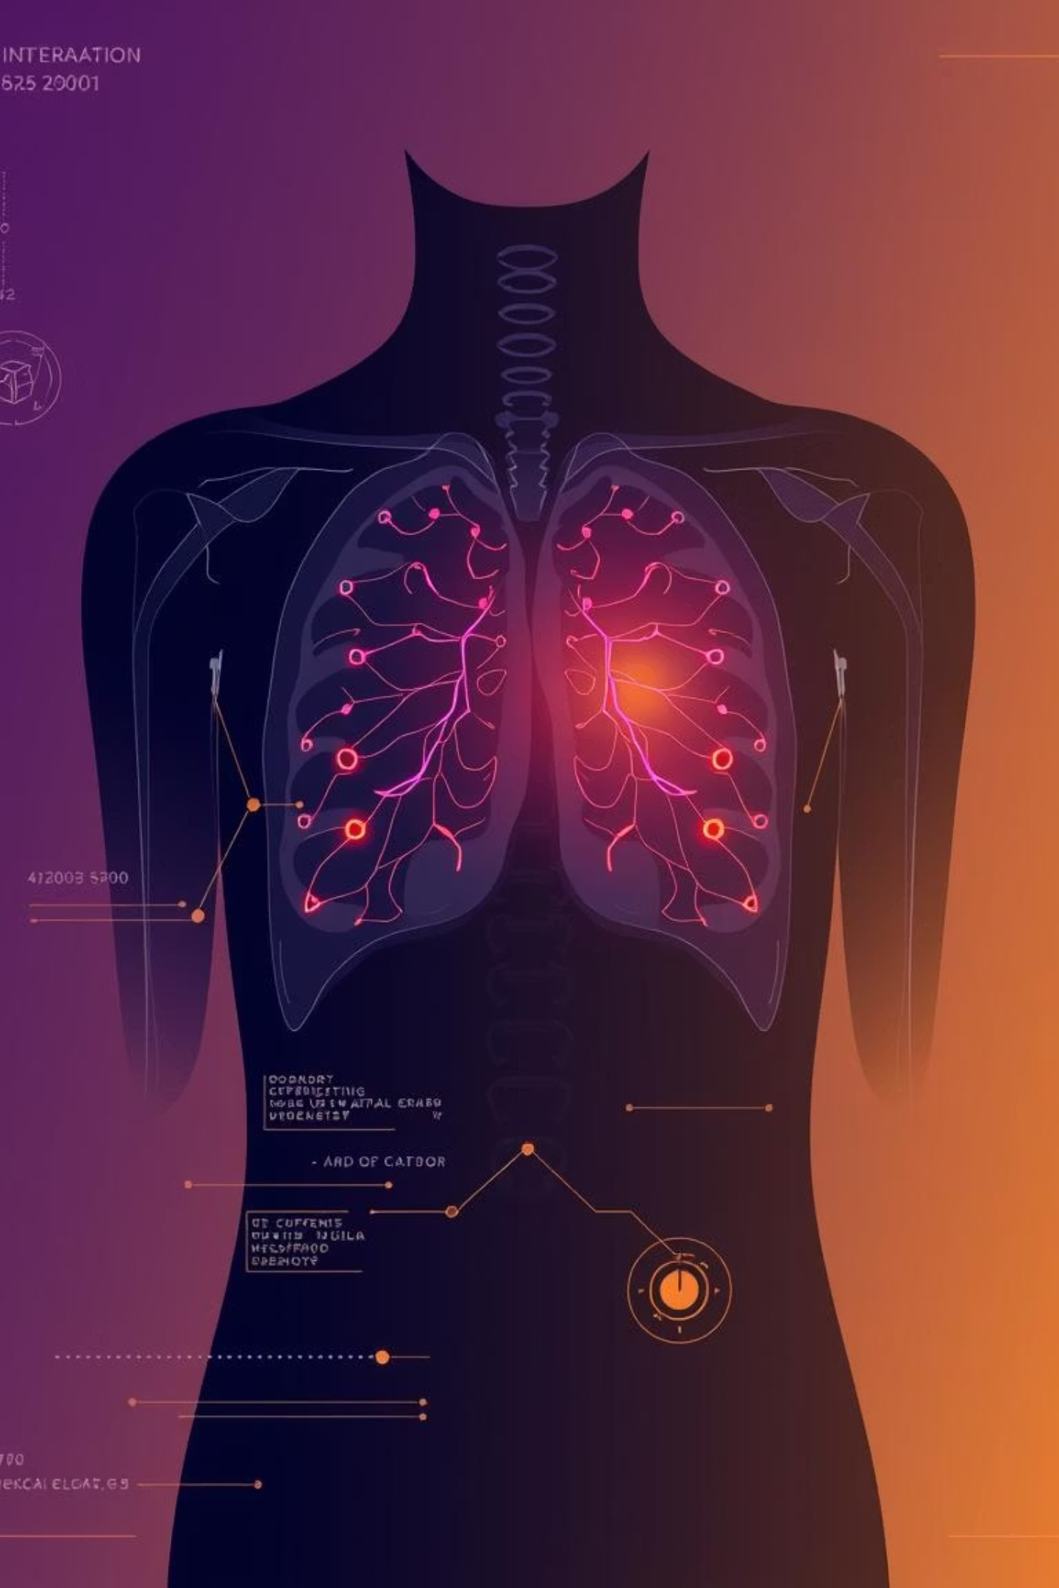
AI-Driven Pneumonia Detection System
Efficient & Explainable Diagnosis using Chest X-Rays
Powered by EfficientNetB0 & Flask

Slide 2


The Medical Challenge: Pneumonia's Deadly Impact
1
2
3
Global Mortality
Expert Shortage
Our Vision
Pneumonia causes over 2.5 million deaths annually, making it the leading infectious killer worldwide.
Accurate diagnosis requires expert radiologists, who are often in critical short supply, especially in underserved regions.
To develop an automated "Second Opinion" tool that assists doctors in real-time, enhancing diagnostic capabilities.

Slide 3
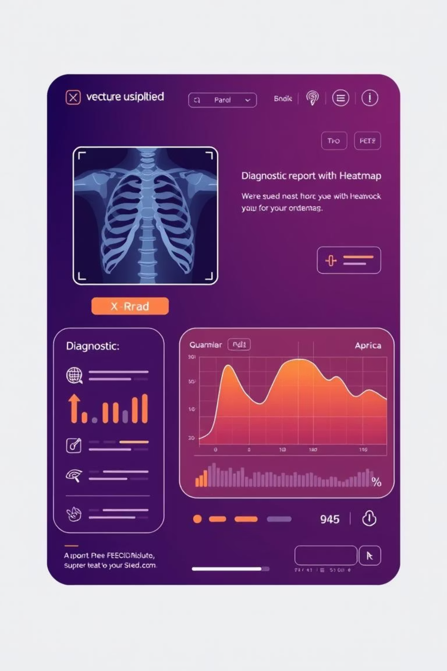



Solution Overview: End-to-End Web Application
We have developed a comprehensive web application designed to streamline pneumonia diagnosis.
Input
Digital Chest X-Rays (CXR) are uploaded to the system.
Processing
The system performs a series of checks and classifications.
Output
Provides a detailed diagnostic report and visual aids.

Slide 4
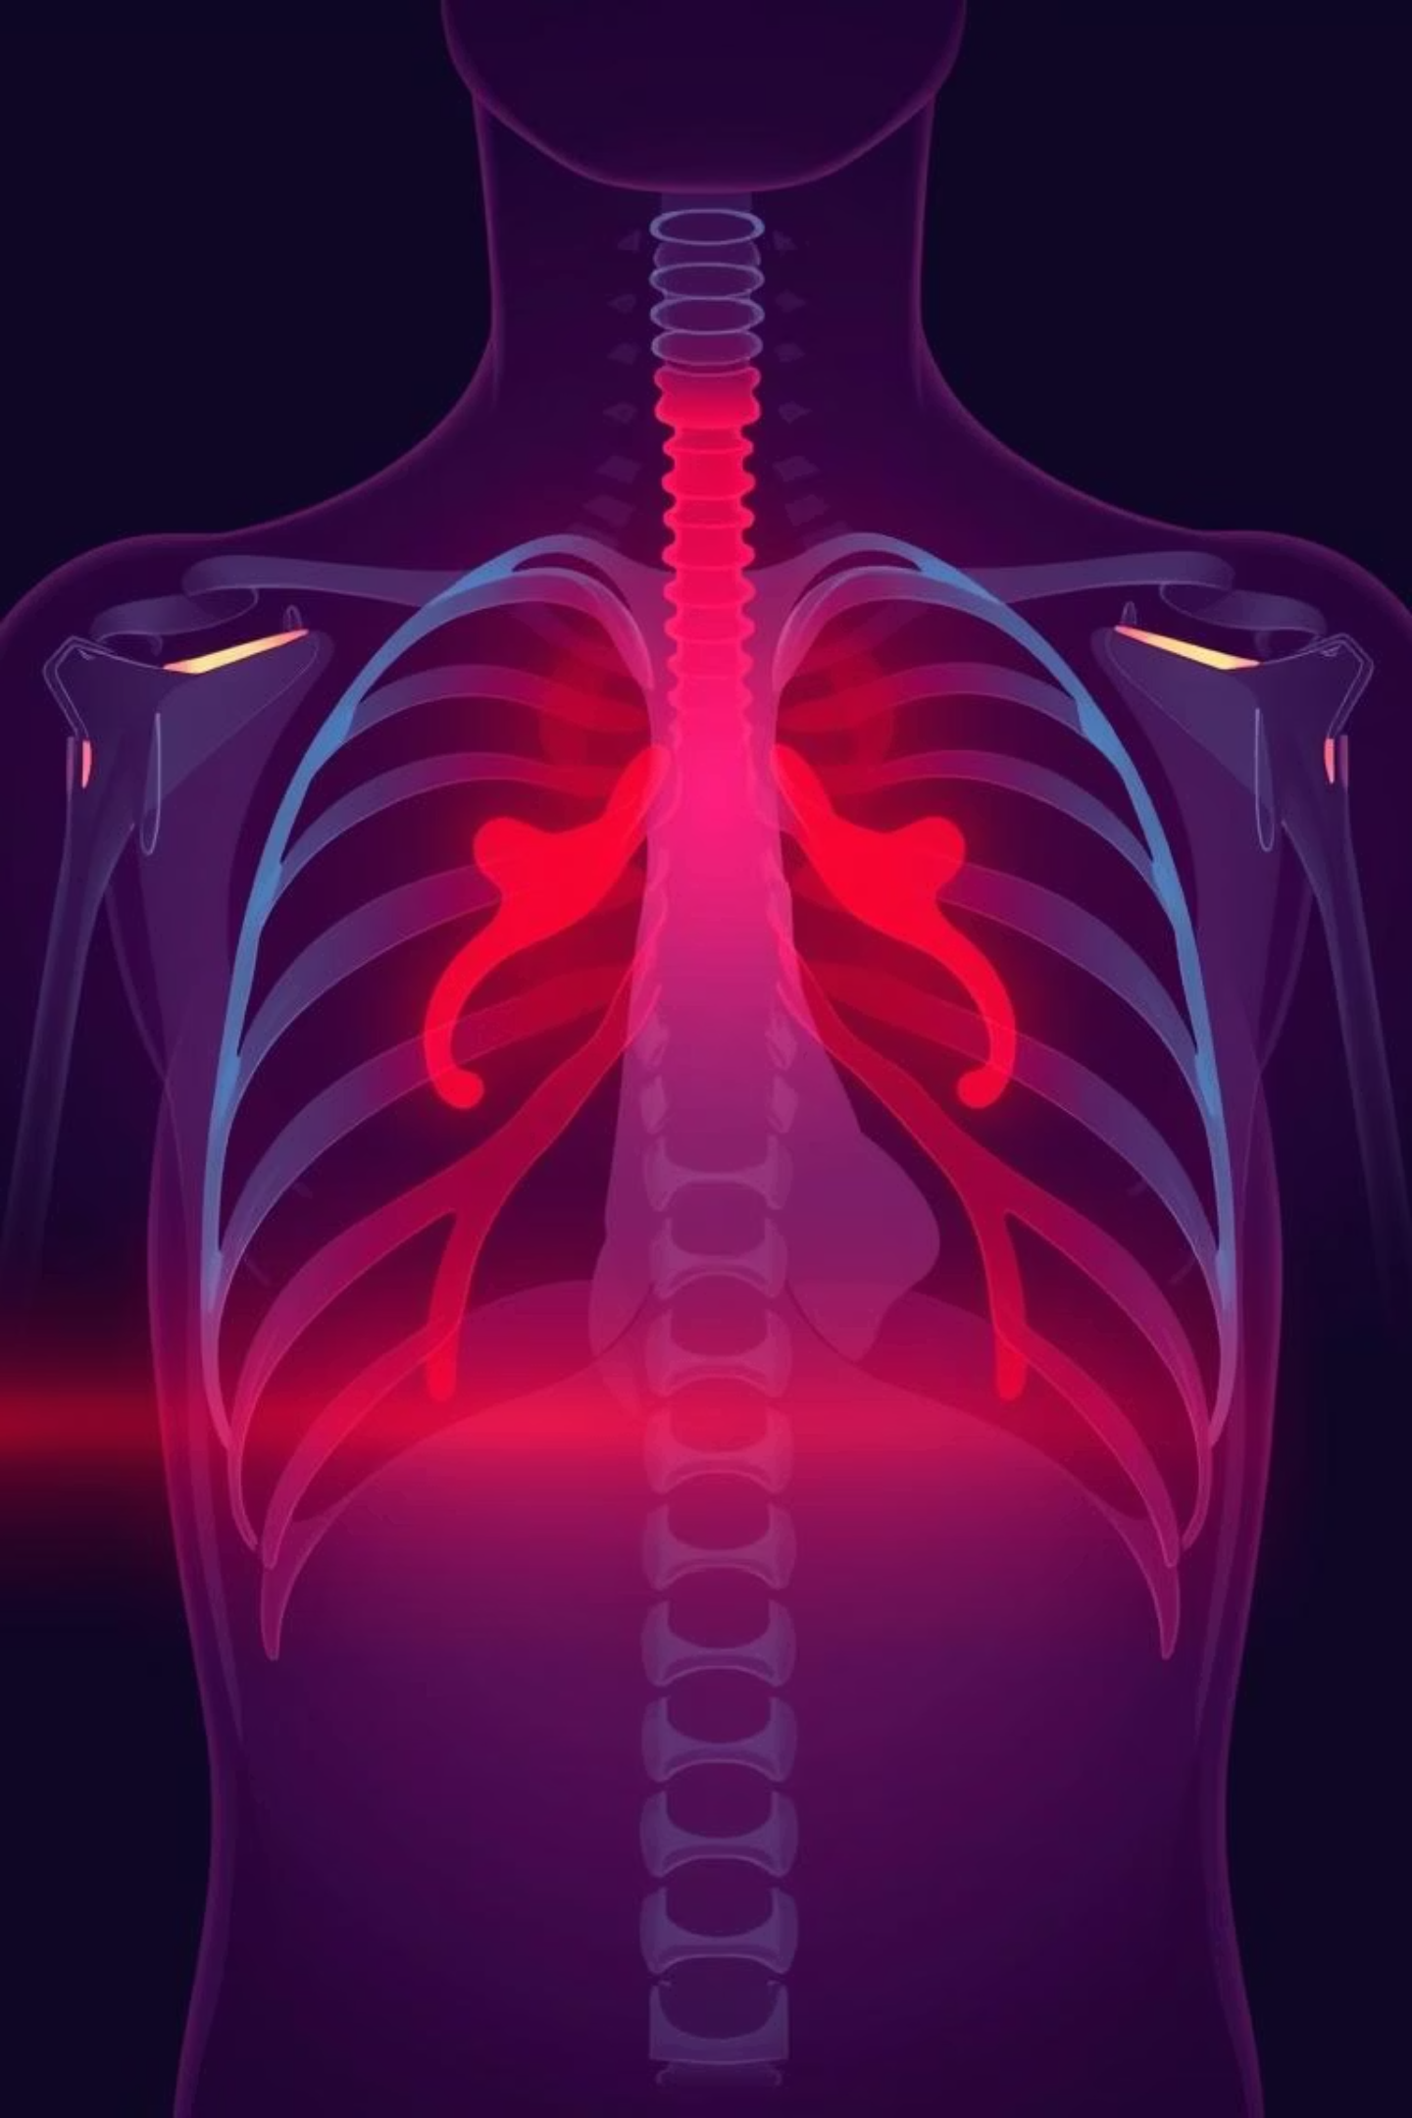
Detailed Output: Comprehensive Diagnostic Insights
Validity Check
Ensures the uploaded image is indeed an X-ray, preventing erroneous inputs.
Disease Classification
Categorizes the X-ray into 6 distinct disease classes, including pneumonia.
Visual Explanation
Generates a Grad-CAM heatmap highlighting areas of concern on the X-ray.
Confidence Score
Provides a numerical score indicating the AI's certainty in its diagnosis.

Slide 5




Key Differentiators: Efficiency, Safety, Interpretability
Efficiency
Utilizes EfficientNetB0, a lightweight model optimized for deployment on edge devices and web platforms.
Safety
Incorporates a "Gatekeeper" model to reject invalid images, enhancing security and diagnostic reliability.
Interpretability
Employs Grad-CAM to visually explain the AI's decision-making process, fostering trust and understanding.

Slide 6

The Power of EfficientNetB0
EfficientNetB0 is a convolutional neural network known for its balance of accuracy and efficiency. Its compact size makes it ideal for real-time applications and deployment in resource-constrained environments.
Optimized for performance on various hardware.
Reduced computational cost without sacrificing accuracy.
Enables faster inference times for quick diagnoses.
Suitable for integration into mobile and web applications.

Slide 7








Ensuring Safety with the Gatekeeper Model
Our "Gatekeeper" model acts as a crucial first line of defense, ensuring that only valid chest X-ray images are processed by the diagnostic system. This prevents misdiagnosis from incorrect inputs.
Image Upload
Gatekeeper Check
User uploads a chest X-ray image.
Model verifies image validity (is it an X-ray?).
Valid Image
Invalid Image
If valid, image proceeds to diagnostic classification.
If invalid, image is rejected with feedback.

Slide 8
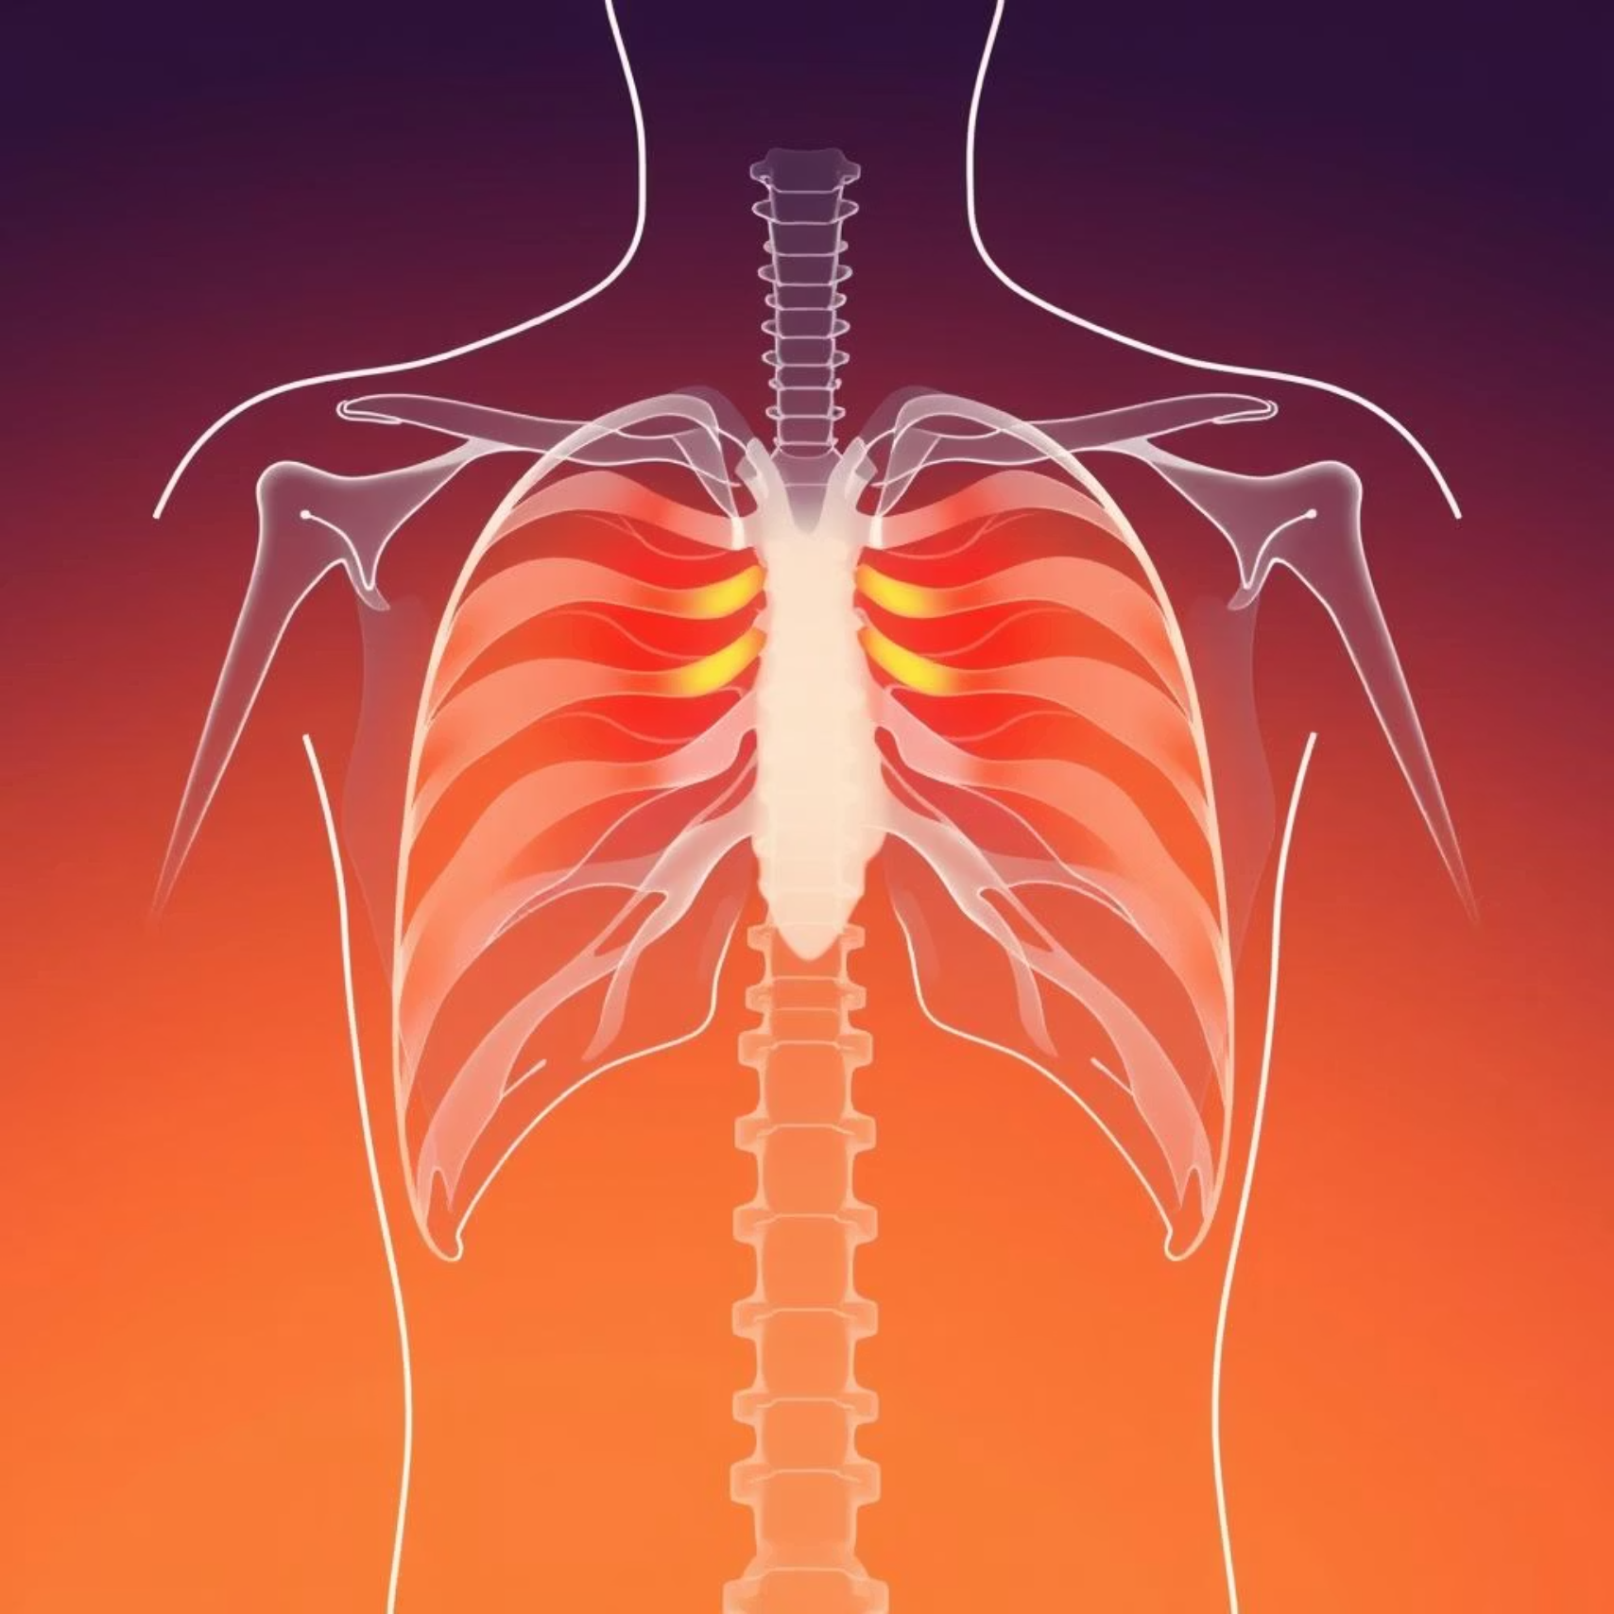
Interpretability with Grad-CAM Heatmaps
Grad-CAM (Gradient-weighted Class Activation Mapping) provides visual explanations for the AI's predictions. It generates heatmaps that highlight the specific regions in the X-ray image that influenced the model's decision.
Increases trust in AI diagnoses.
Helps clinicians understand the AI's reasoning.
Identifies critical areas for human review.
Facilitates learning and model improvement.

Slide 9
The Flask Web Application: User-Friendly Interface
Our system is built as a Flask web application, offering a user-friendly interface for seamless interaction. This allows medical professionals to easily upload X-rays and receive immediate diagnostic feedback.
Intuitive Upload
Instant Results
Accessible Anywhere
Simple drag-and-drop or file selection for X-ray images.
Quick display of classification, confidence, and heatmap.
Web-based platform accessible from any device with internet.

Slide 10



Future Outlook & Impact
This AI-driven pneumonia detection system has the potential to significantly enhance diagnostic accuracy and efficiency, particularly in areas with limited access to expert radiologists.
Global Health
Improve pneumonia diagnosis in underserved communities.
Clinical Support
Provide valuable "second opinions" for medical professionals.
Research & Development
Foundation for further AI advancements in medical imaging.

Slide 11

Revolutionizing Medical Imaging with AI
Discover how cutting-edge AI and deep learning are transforming the landscape of medical diagnostics, particularly in the analysis of chest X-rays for critical conditions.

Slide 12

Data & Engineering: The Foundation
Our journey into AI-powered diagnostics begins with robust data and sophisticated engineering. This section delves into the critical aspects of dataset management and pipeline optimization.

Slide 13
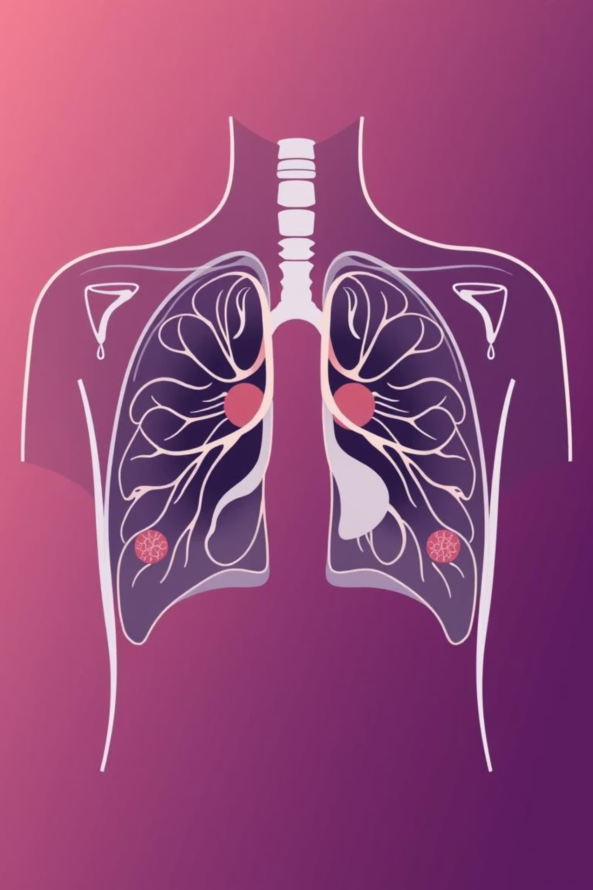
The Chest X-Ray Dataset
Source & Size
Key Classes
Combined Chest X-Ray Database with approximately 30,000 images.
Normal
Lung Opacity
COVID-19
Viral Pneumonia
Bacterial Pneumonia
Tuberculosis
Major Challenge
Severe Class Imbalance: Thousands of "Normal" images versus very few "COVID-19" cases.

Slide 14
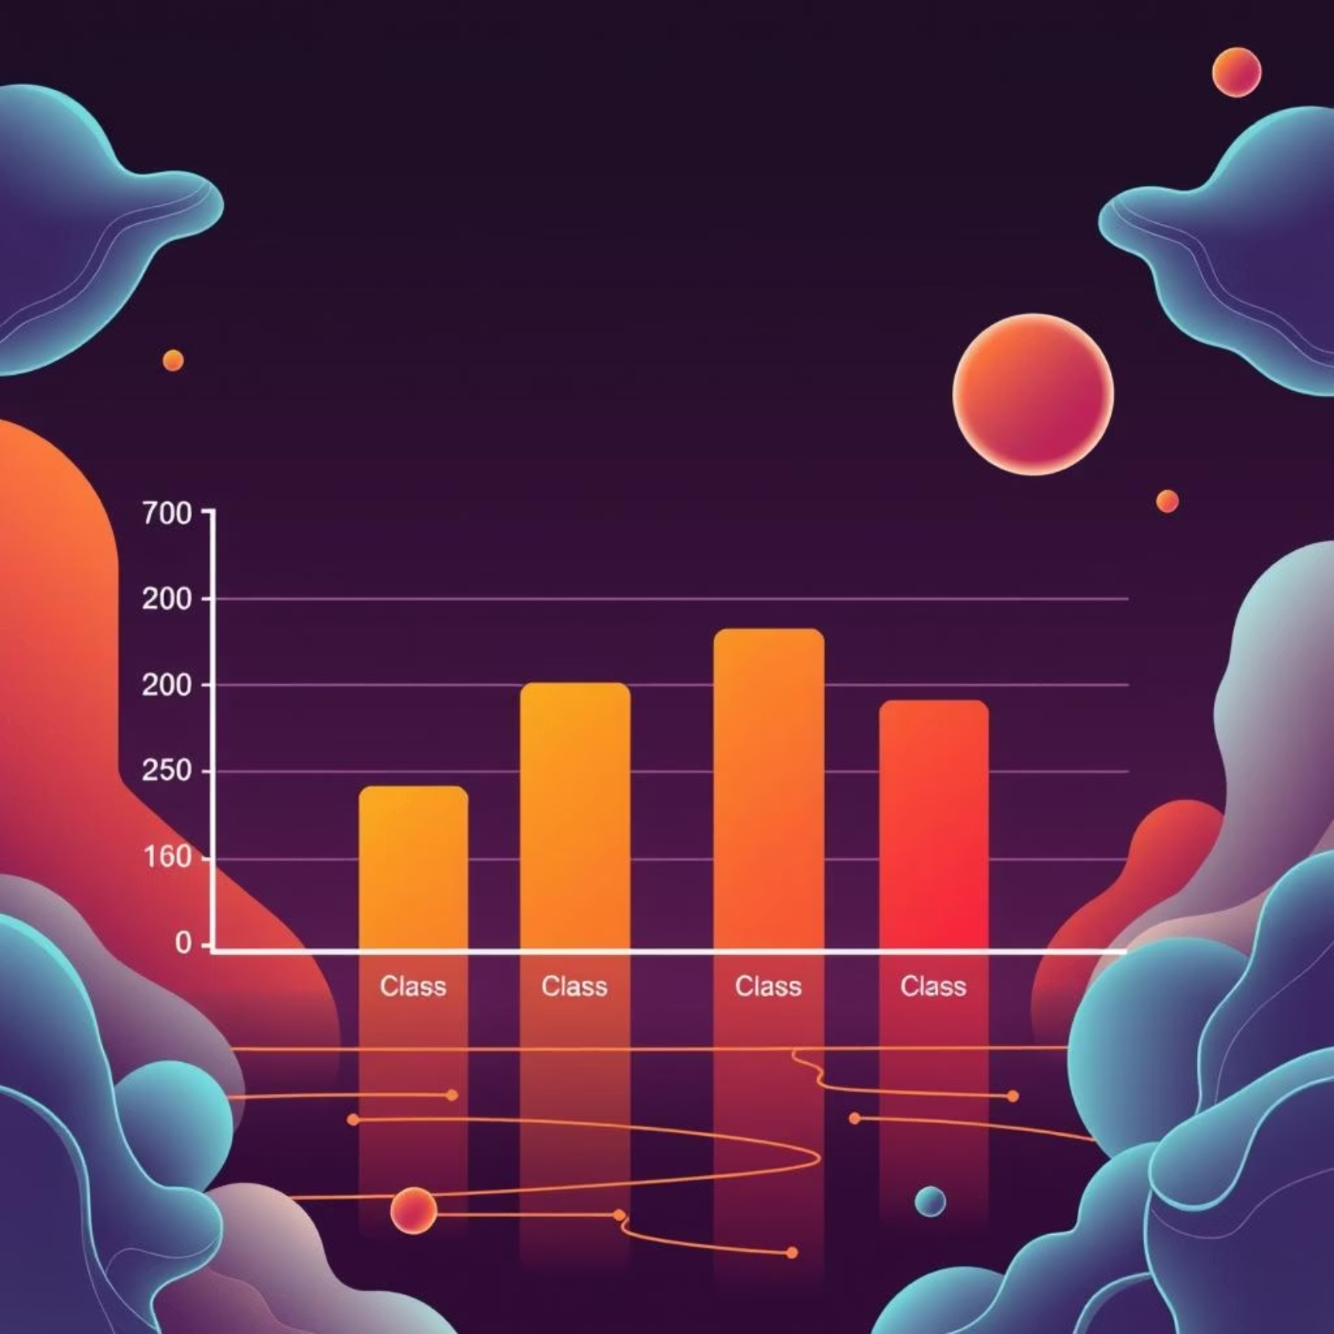

Addressing Data Imbalance: Initial Attempts
Experiment A: Balanced Subset
Result: Poor Accuracy
We initially created a "Balanced" subset, reducing each class to 700 images to achieve equilibrium.
This approach yielded only 76% accuracy, indicating a significant flaw in the strategy.
Insight: Deep Learning models thrive on large datasets. Reducing data, even for balancing, discards valuable information and hinders performance.

Slide 15




Successful Strategy: Class Weighting
Full Dataset
Utilized the entire 30,000-image dataset to maximize information for the model.
Class Weighting
Implemented a technique where the model incurs a higher penalty for misclassifying rare classes.
Dramatic Improvement
Accuracy immediately jumped to over 83%, validating the approach.

Slide 16

Big Data Pipeline Optimization
Efficient data handling is crucial for deep learning. We identified and resolved a major bottleneck in our pipeline.
1
The Bottleneck
Loading 30,000 individual files from Google Drive was extremely slow, taking hours for each training epoch.
2
Solution: Archiving
Archived all data into a single tar.gz file for consolidated transfer.
3
Local Transfer
Copied the archive directly to the local Colab Runtime environment.
4
Local Extraction
Extracted the data locally within the Colab environment for rapid access.

Slide 17


Accelerated Training: A Remarkable Speedup
Before Optimization
After Optimization
Each training epoch took a staggering 40 minutes due to inefficient data loading.
The optimized pipeline reduced training epoch time to just 2 minutes, a 20x improvement!

Slide 18







Impact of Engineering Excellence
Faster Iteration
Increased Efficiency
Significantly reduced development cycles, allowing for more experiments and faster model improvements.
Maximized resource utilization and minimized idle time, leading to more productive research.
Accelerated Innovation
Enabled quicker testing of new hypotheses and faster deployment of advanced AI models.

Slide 19

Key Takeaways: Data & Engineering
1
Data Volume is Key
Deep learning models require extensive data; balancing by reduction is often counterproductive.
2
Smart Imbalance Handling
Techniques like class weighting are crucial for robust models when dealing with skewed datasets.
3
Pipeline Optimization
Efficient data pipelines are fundamental for rapid experimentation and model training.

Slide 20

Next Steps in AI Diagnostics
Building on these foundational successes, our next phase focuses on refining model accuracy, expanding to new diagnostic areas, and integrating AI solutions into clinical workflows.

Slide 21

The Gatekeeper: Securing Our Medical AI
Our medical AI system requires robust security to prevent misdiagnosis from irrelevant inputs. The "Gatekeeper" acts as a crucial first line of defense, ensuring that only appropriate data reaches the diagnostic model.

Slide 22

System Vulnerability: The "Cat = Tuberculosis" Problem
Scenario
Result Without Gatekeeper
A user uploads a non-medical image, such as a photo of a cat or a random document.
The medical AI, designed for X-rays, forces an incorrect diagnosis (e.g., "Cat = Tuberculosis").
The Critical Need
A sophisticated filter is essential to reject non-medical images, safeguarding diagnostic accuracy.

Slide 23






Gatekeeper Architecture: Speed and Precision
Task: Binary Classification
Distinguishes between "X-Ray" and "Other" image types.
Model: MobileNetV2
Selected for its extreme speed and efficiency in image processing.
Training Data
Trained on a diverse dataset of X-rays combined with random ImageNet objects.

Slide 24

Gatekeeper Results: 100% Accuracy
100%
First Step
Valid Data
Accuracy
Implementation
Impact
Achieved perfect accuracy on the validation set, demonstrating flawless filtering.
Deployed as the initial stage in our Flask application pipeline.
Ensures the diagnostic model processes only valid medical images, enhancing reliability.

Slide 25

Model Evolution: The Search for Efficiency
Our journey to optimize the medical AI involved significant model evolution, focusing on both accuracy and computational efficiency. This iterative process led us to more advanced and streamlined architectures.

Slide 26
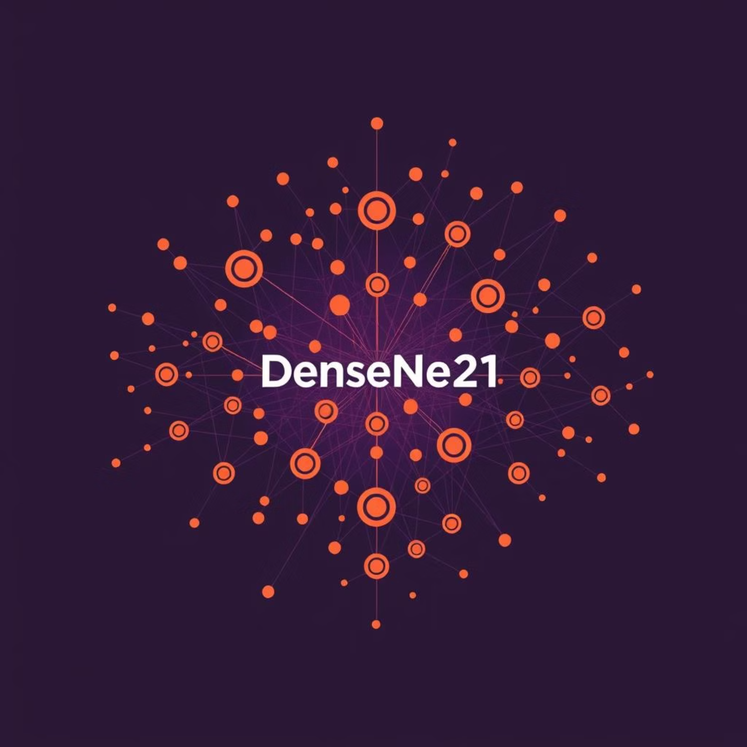
Phase 1: The DenseNet121 Era
Initially, we leveraged DenseNet121, a standard architecture in medical imaging, for its proven capabilities in complex visual tasks.
Architecture: DenseNet121, a robust choice for image analysis.
Performance: Stalled at approximately 83.5% accuracy, indicating a plateau.
Issue: Faced challenges with heavy computation and difficulty distinguishing subtle viral vs. bacterial patterns in X-rays.

Slide 27
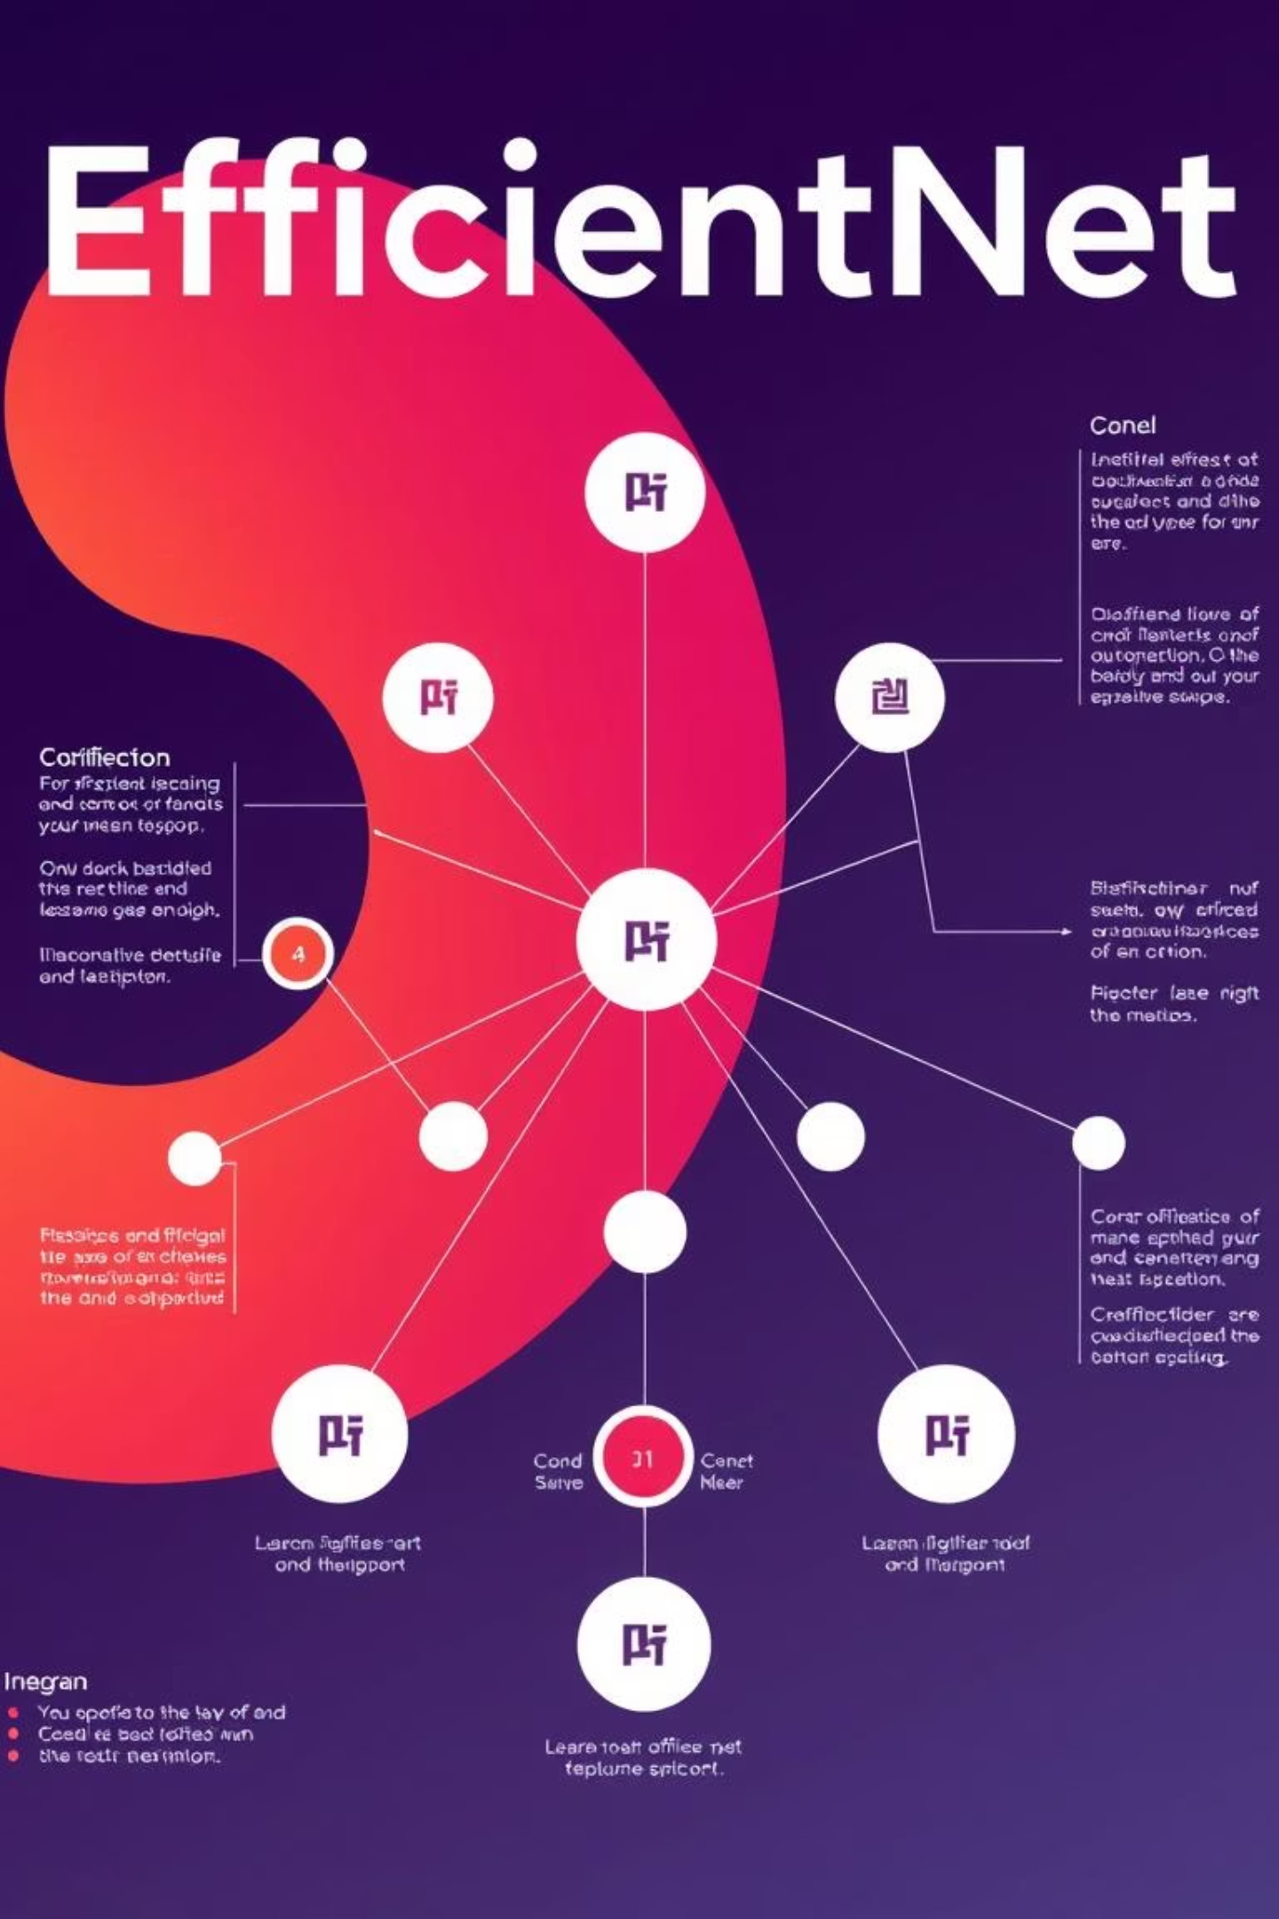






Phase 2: Enter EfficientNetB0
Why B0?
Parameters
Optimized for an ideal balance between speed and accuracy, crucial for real-world deployment.
Significantly fewer parameters at ~5.3 Million, compared to VGG16's 138 Million.
Key Benefits
Offers faster inference, a smaller file size, and easier deployment across various platforms.

Slide 28
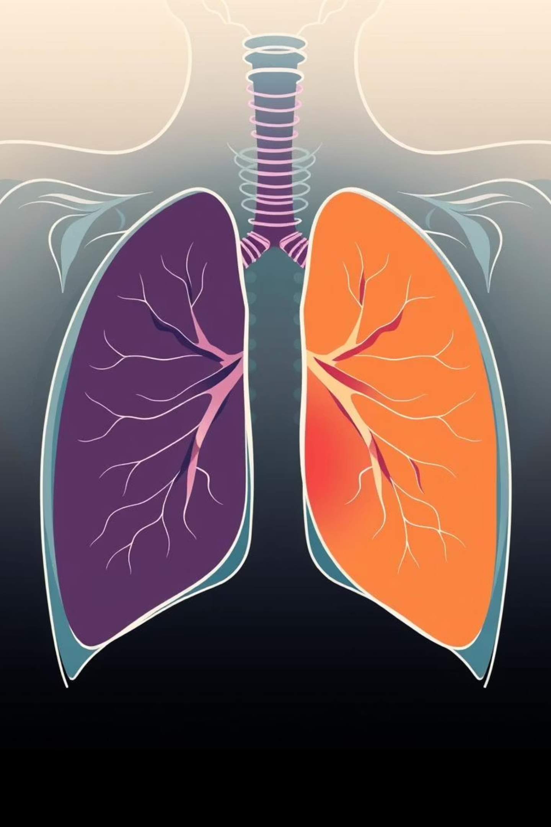
Training EfficientNetB0: Binary Classification
Our training regimen for EfficientNetB0 focused on binary classification, specifically distinguishing between pneumonia and normal cases, incorporating various augmentation techniques to enhance robustness.

Slide 29


EfficientNetB0 Training Results
93%
97%
Test Accuracy
Recall
Achieved a high test accuracy, demonstrating strong predictive power.
Crucial for not missing sick patients, ensuring high sensitivity in detection.
These results highlight EfficientNetB0's effectiveness in accurately identifying pneumonia, with a strong emphasis on minimizing false negatives to ensure patient safety.

Slide 30
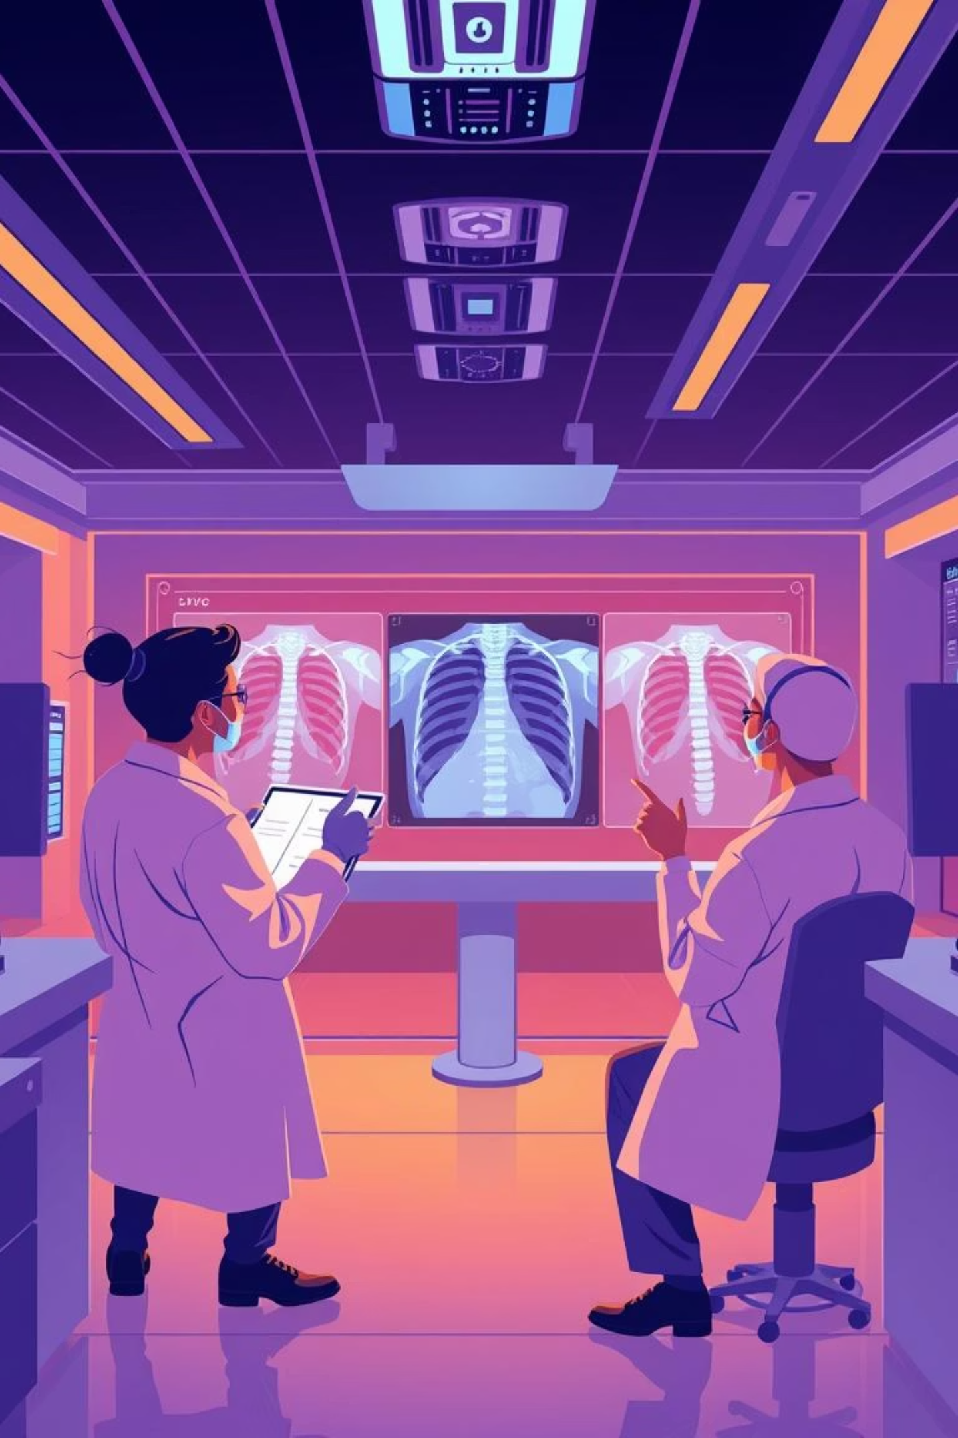
The Path Forward: Enhanced Diagnostics
The integration of the Gatekeeper and the optimized EfficientNetB0 model marks a significant leap in our medical AI's capability. We are committed to continuous improvement, ensuring our diagnostic tools are both accurate and efficient.

Slide 31
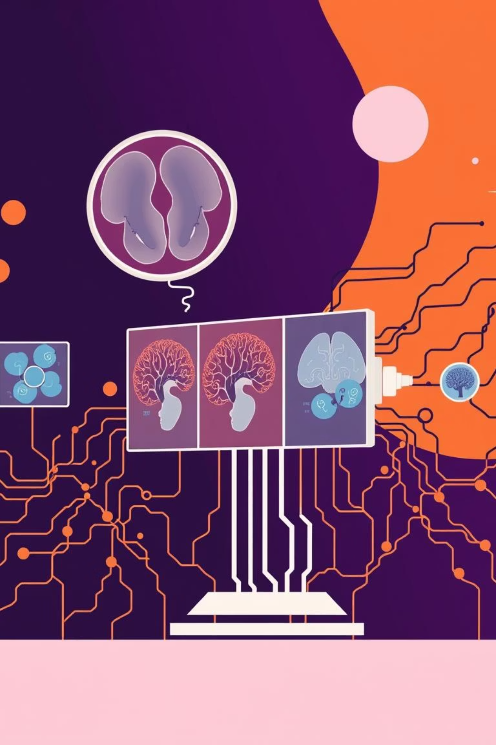
EfficientNetB0: A Multiclass Diagnosis Model
Our project involved training an EfficientNetB0 model for a 6-class diagnostic task. This sophisticated approach leveraged transfer learning and fine-tuning to achieve high accuracy in medical image analysis.

Slide 32
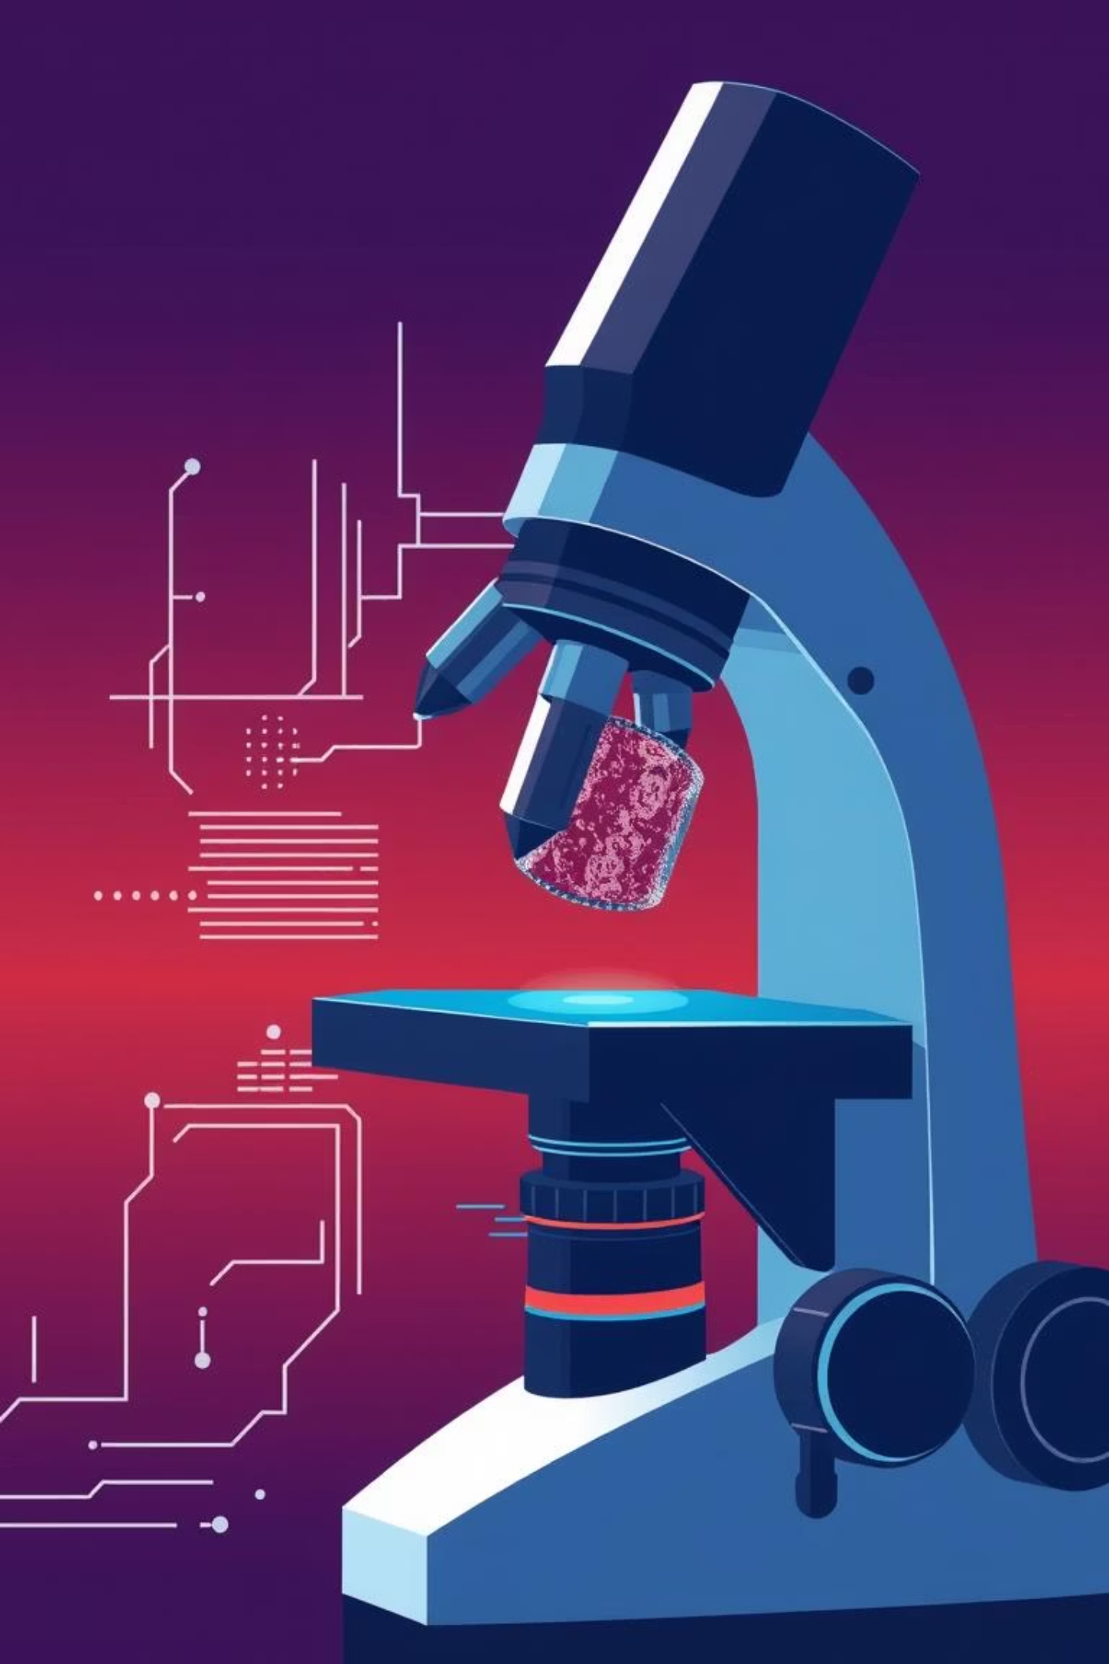
Training Strategy: A Three-Phase Approach
01
02
Freeze Base Layers
Train Custom Head
We initiated training by freezing the base layers of the pre-trained EfficientNetB0 model, utilizing the power of transfer learning to leverage existing knowledge.
Following the base layer freezing, a custom classification head was trained, allowing the model to adapt specifically to our 6-class diagnostic task.
03
Unfreeze & Fine-tune
The final phase involved unfreezing the top layers and fine-tuning the entire network with a very low learning rate (1e-5), optimizing performance for our specific dataset.

Slide 33
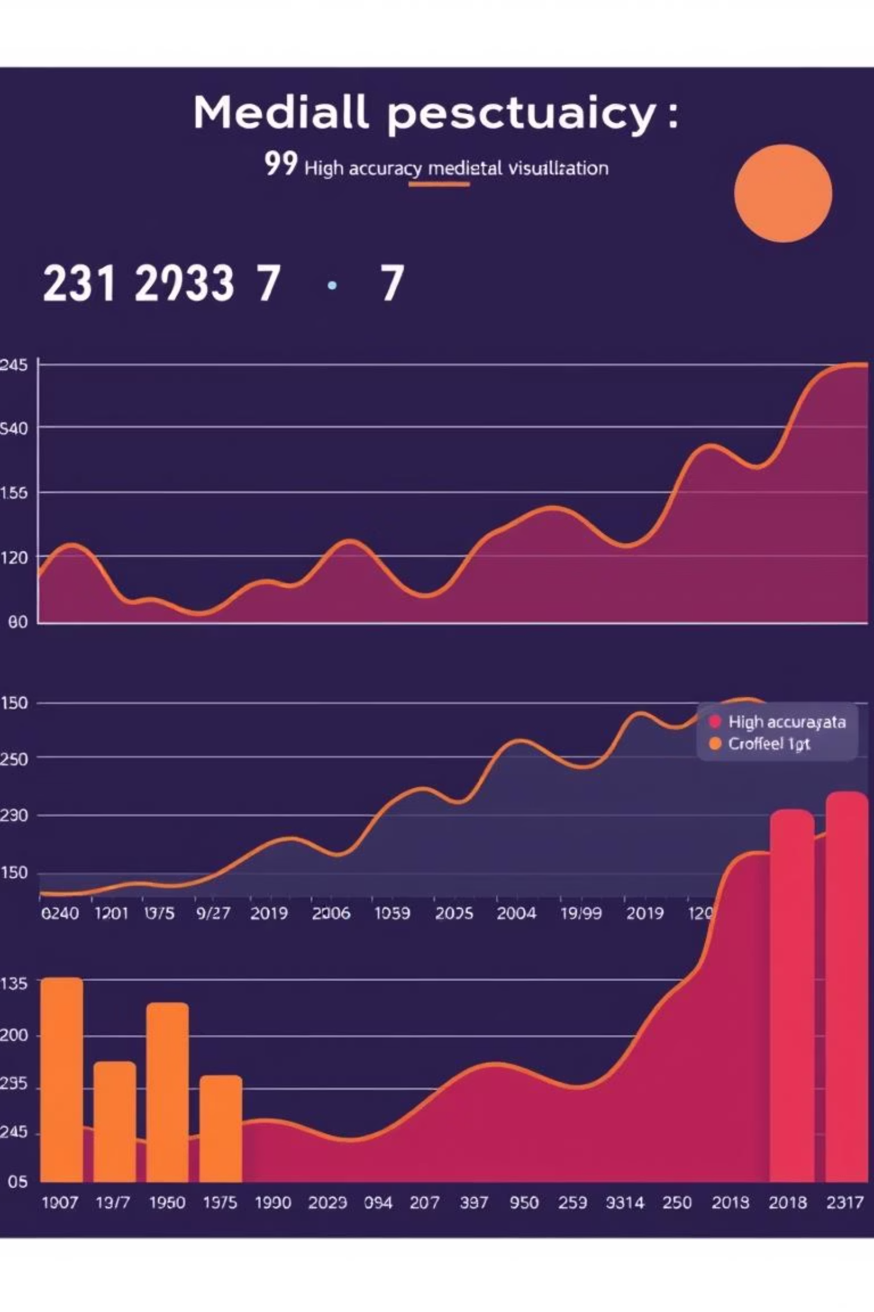
Achieving High Accuracy
85.02%
Test Accuracy
Through our meticulous training strategy, the EfficientNetB0 model achieved an impressive 85.02% test accuracy for the 6-class diagnostic task, demonstrating its robust performance.

Slide 34

Advanced Optimization Techniques
To further enhance model robustness and prevent common pitfalls, we implemented several advanced optimization techniques. These methods were crucial in ensuring the model learned meaningful features rather than superficial cues.

Slide 35
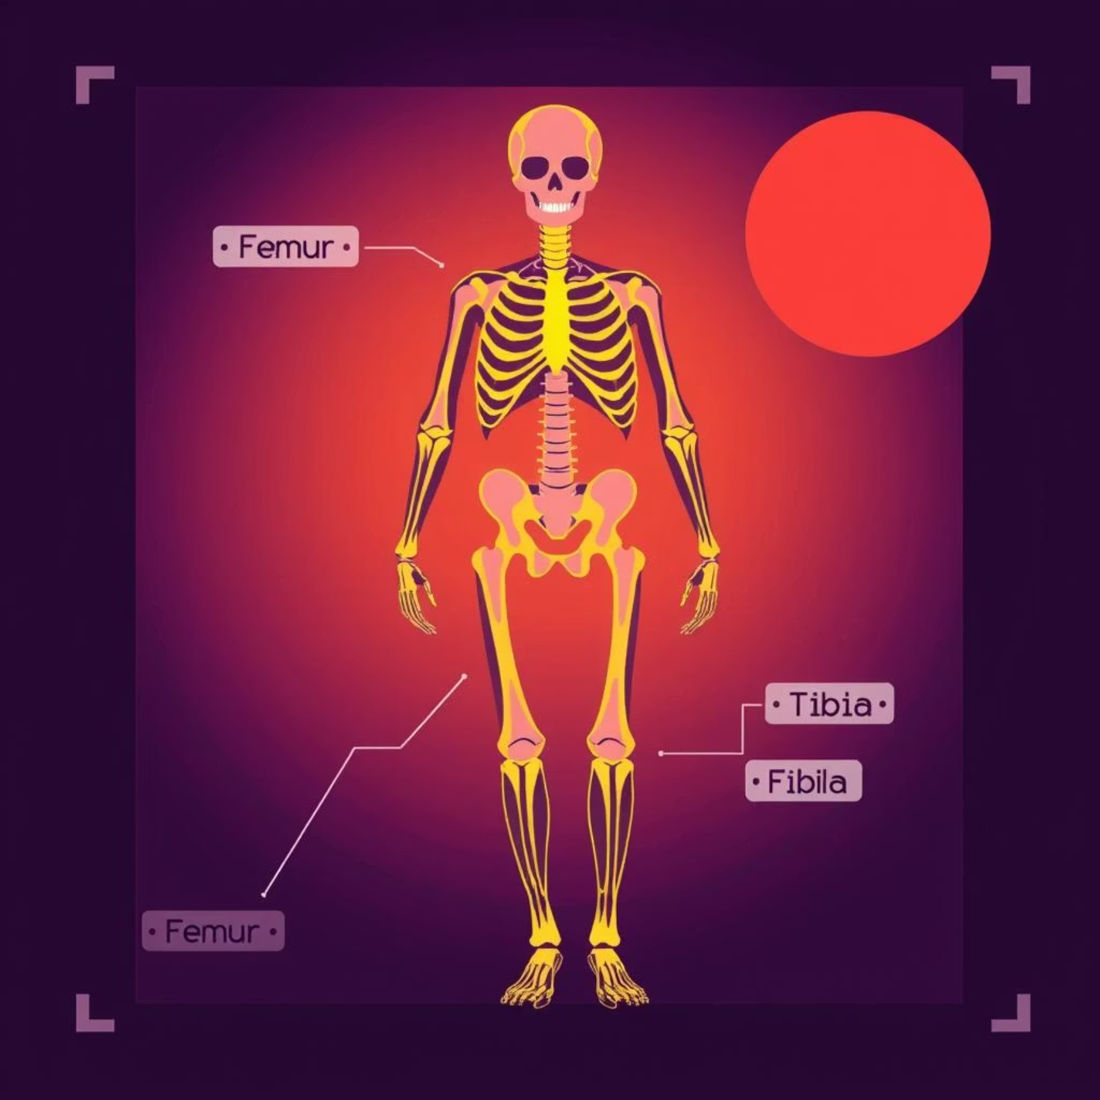
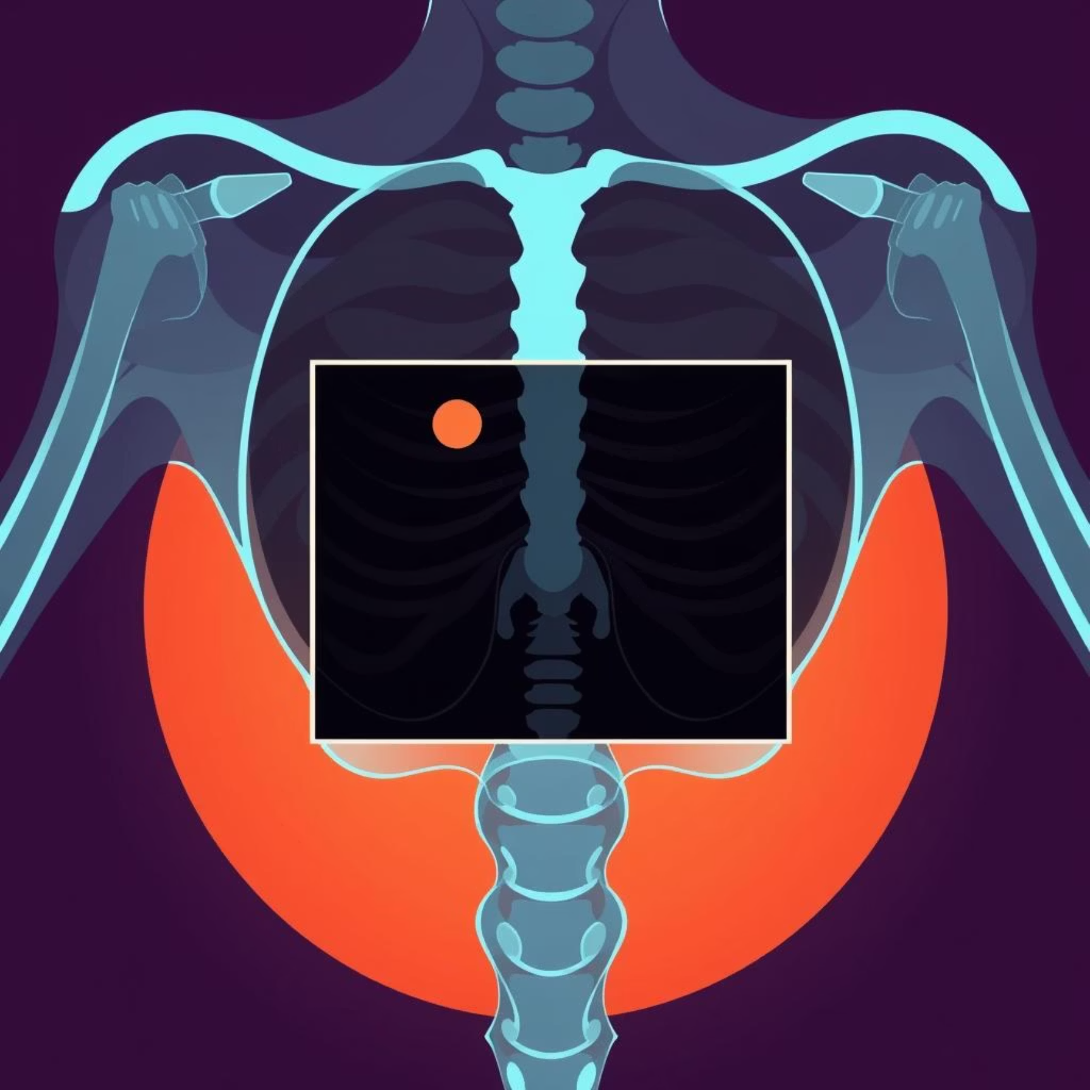
Fighting "Cheating" with Preprocessing
The Problem
The Solution
Early models were "cheating" by classifying X-rays based on text labels ("L", "R") and other artifacts present in the images, rather than the actual medical features.
We implemented smart cropping, removing 15-20% of the image borders, and random zooming to eliminate these misleading cues, forcing the model to focus on relevant medical information.

Slide 36




RandAugment: Enhancing Data Diversity
Methodology
Random Distortions
We utilized the RandAugment policy, a powerful data augmentation technique, to introduce diverse distortions during the training process.
RandAugment applies a sequence of random distortions such as Shear, Solarize, and Translate to the training images, creating a more varied dataset.
Learning Lung Structure
This technique forces the model to learn the intrinsic structure of the lung, preventing it from merely memorizing pixels and improving generalization.

Slide 37
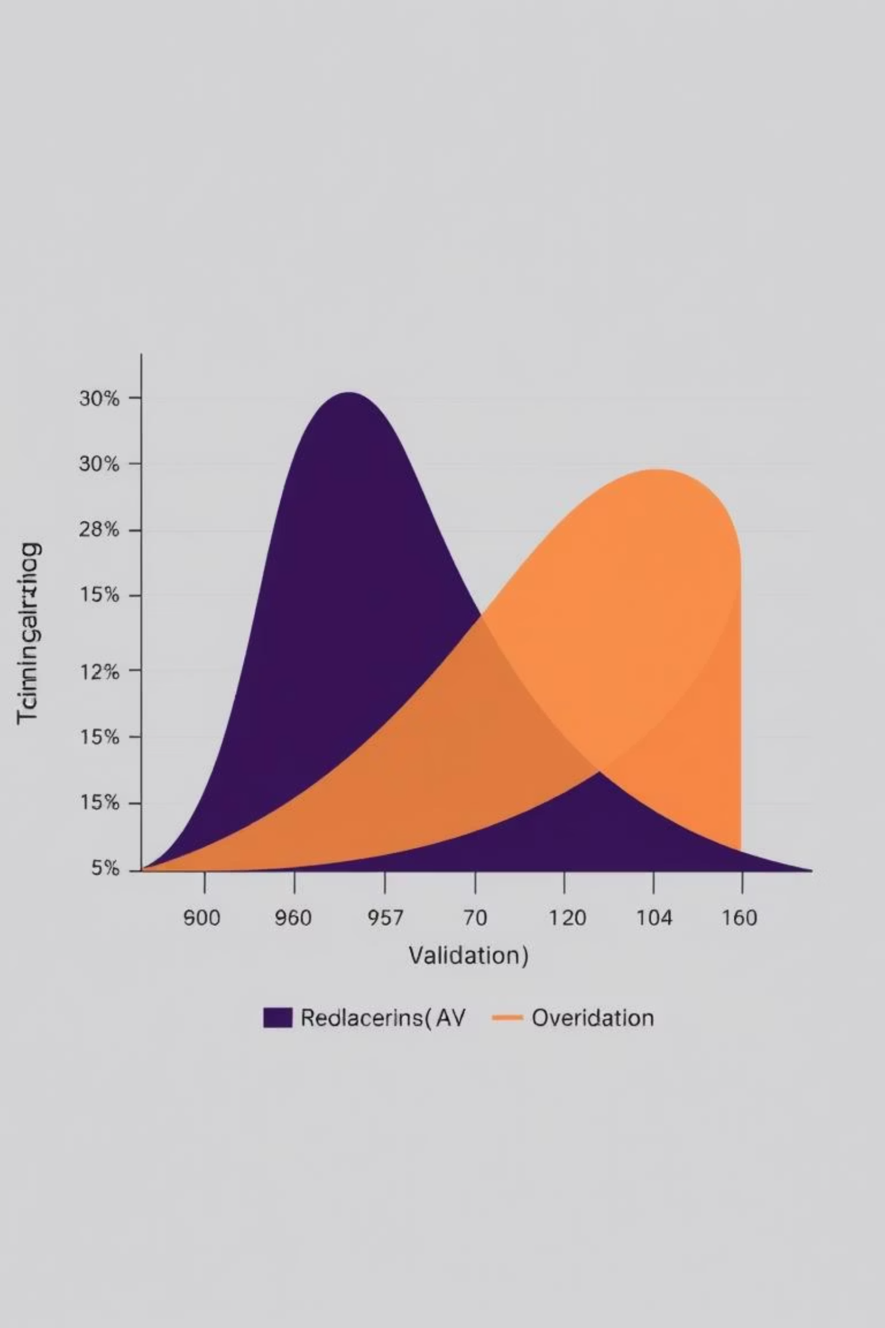




Regularization for Robustness
Dropout (0.5)
Randomly disables 50% of neurons during training, preventing over-reliance on specific features and promoting a more generalized learning.
L2 Regularization
Penalizes large weights, encouraging the model to remain simple and reducing the risk of overfitting to the training data.
These regularization techniques effectively closed the gap between training and validation accuracy, significantly reducing overfitting and improving the model's overall robustness.

Slide 38

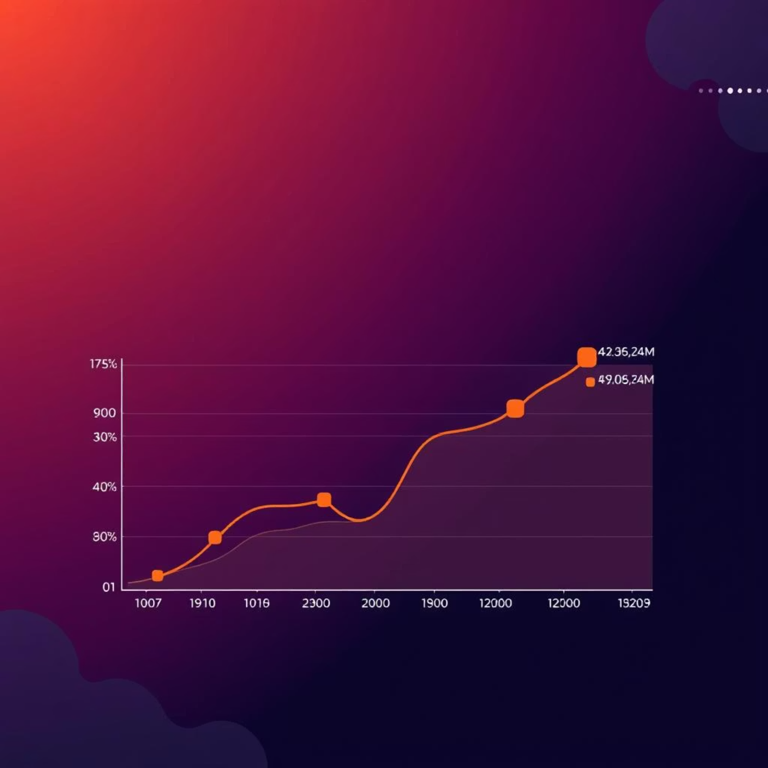
Test Time Augmentation (TTA)
Inference Strategy
Enhanced Reliability
Instead of a single prediction, we perform five predictions on augmented versions of the test image (original, flipped, zoomed, brightened, etc.).
The final output is the average of these five predictions, which significantly increases reliability and provides a valuable uncertainty score for each diagnosis.

Slide 39
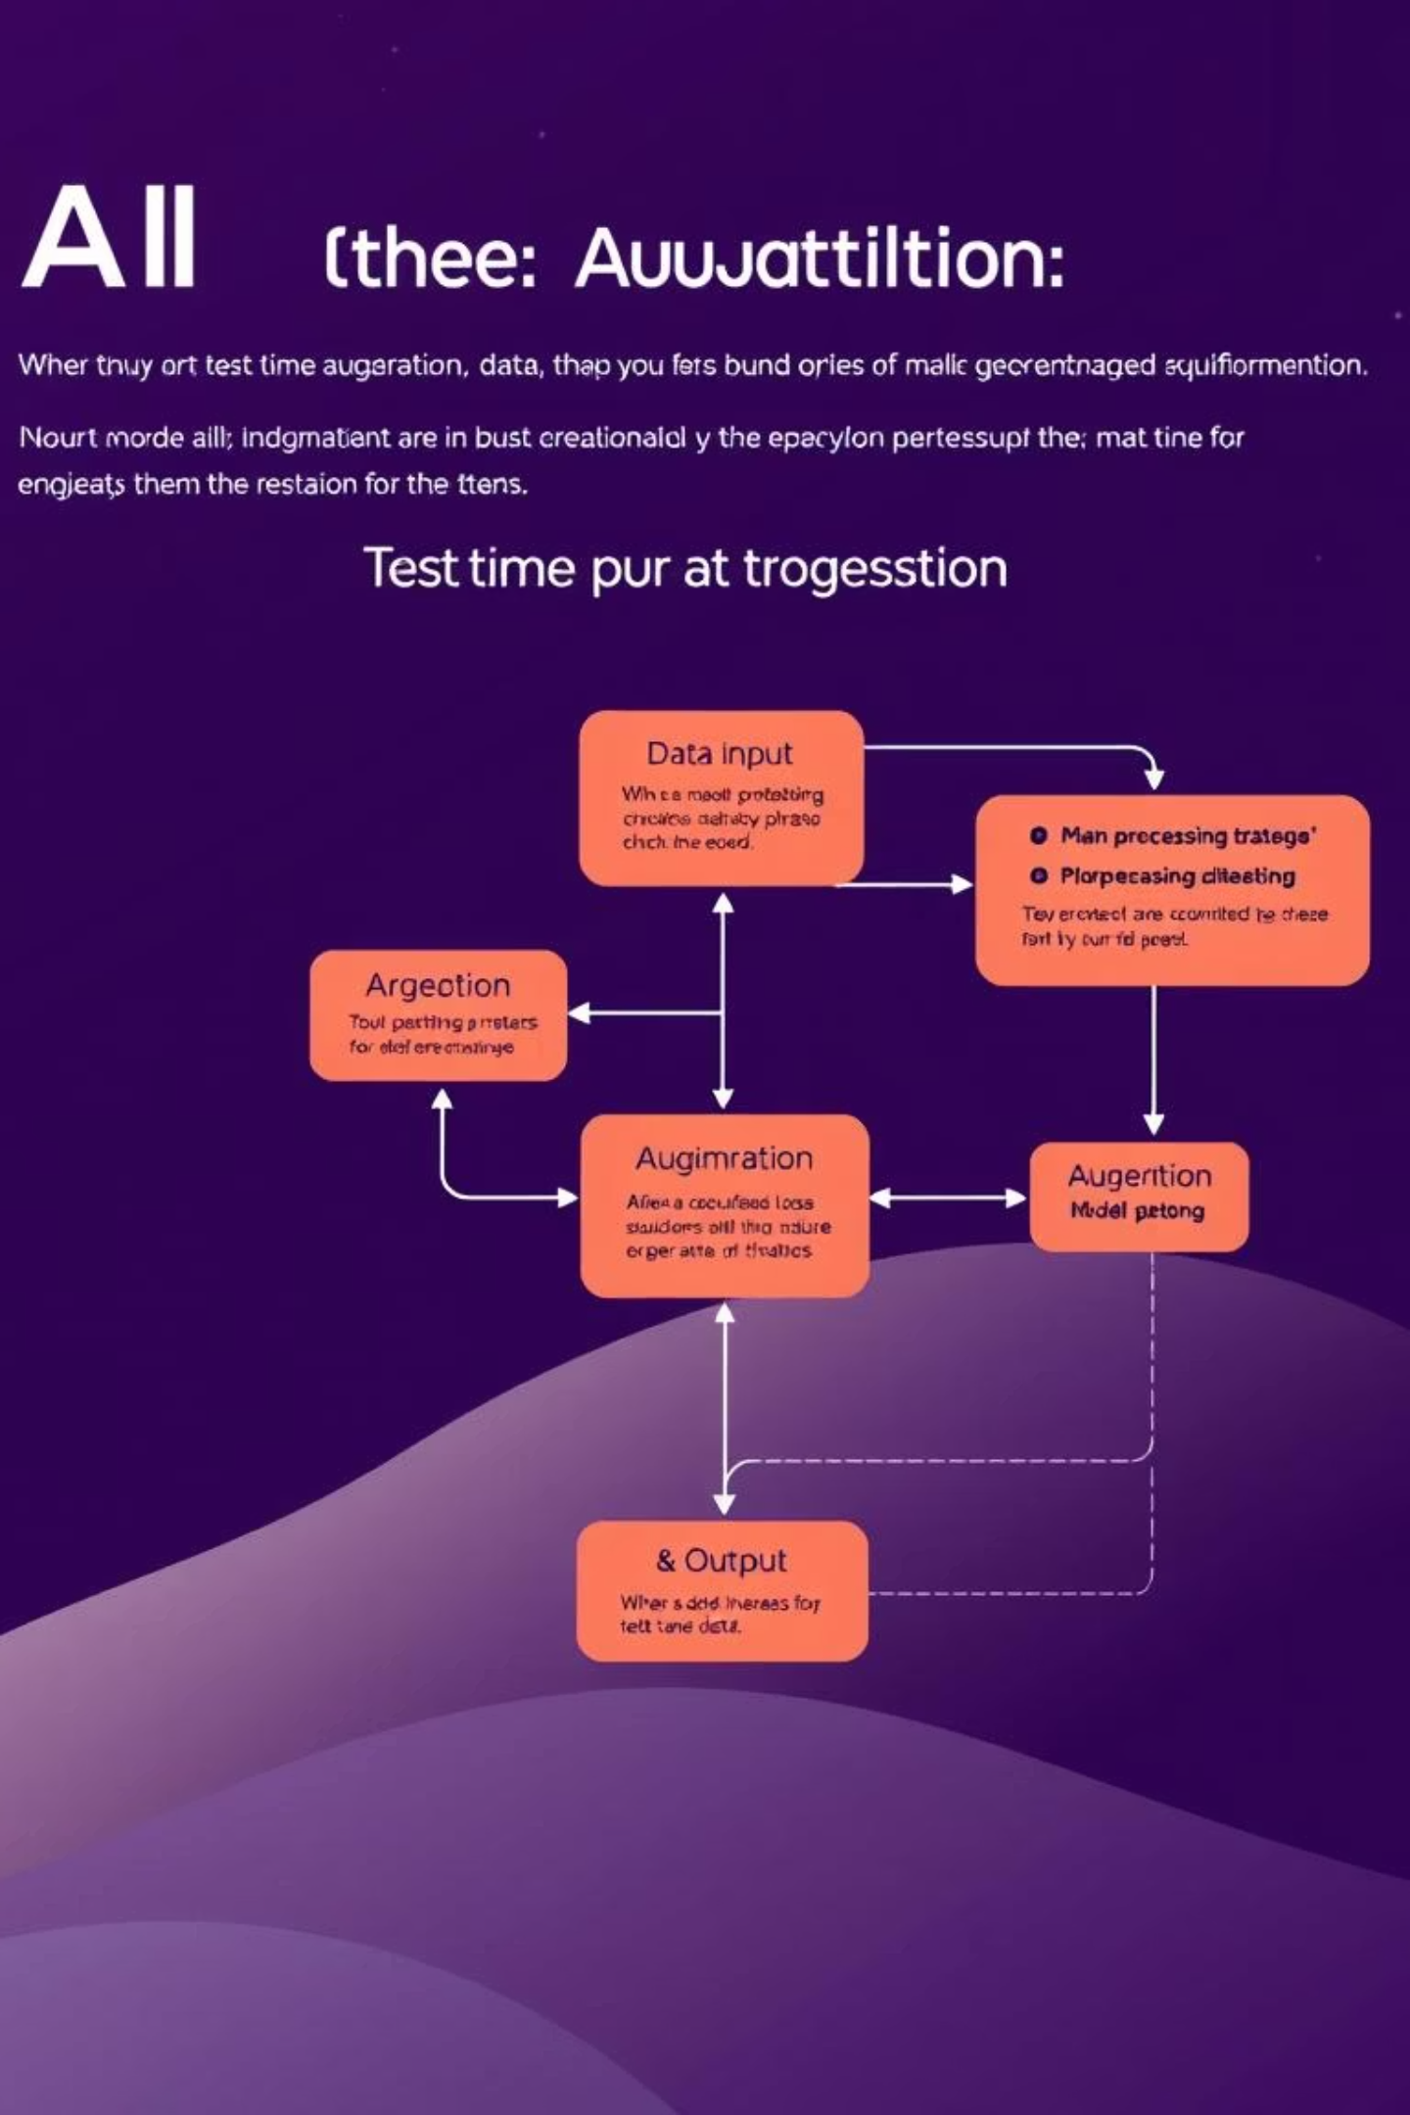




The Power of Ensemble Predictions
Original Image
The initial input for prediction.
Augmented Versions
Flipped, zoomed, brightened, and other transformations.
Individual Predictions
Each augmented image yields a prediction.
Averaged Result
The final, more reliable diagnosis.
This ensemble approach, known as Test Time Augmentation, provides a more robust and confident diagnostic outcome.

Slide 40
Key Takeaways: A Robust Diagnostic Model
High Accuracy
Smart Preprocessing
Data Augmentation
Achieved 85.02% test accuracy for 6-class diagnosis.
Eliminated "cheating" by removing artifacts and labels.
RandAugment forced learning of true lung structure.
Reduced Overfitting
Reliable Inference
Dropout and L2 regularization improved generalization.
Test Time Augmentation boosted prediction reliability.

Slide 41
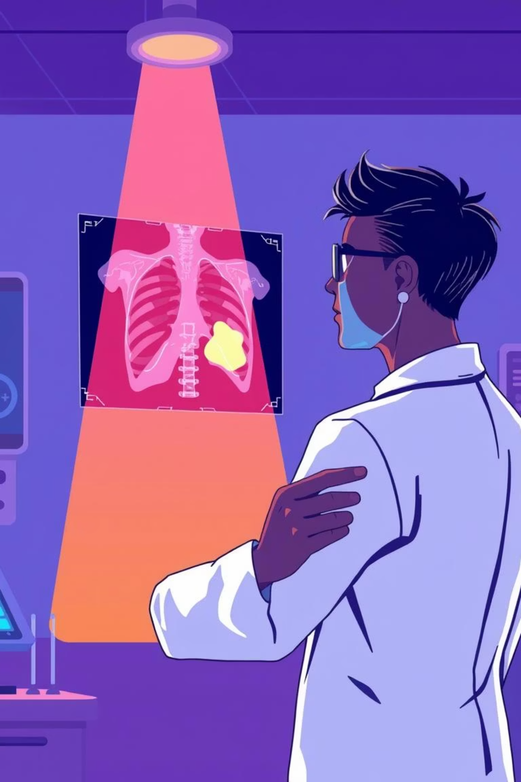
Explainable AI (XAI) for Medical Diagnosis
Understanding why an AI makes a certain diagnosis is crucial, especially in healthcare. This section explores how we address the "black box" issue in our AI model for pneumonia detection.

Slide 42

The "Black Box" Issue in AI
User Need: Transparency
Doctors require clear explanations for AI diagnoses, such as why the AI identifies pneumonia. Blindly trusting AI can lead to critical misdiagnoses.
Risk: Misdiagnosis
Without understanding the AI's reasoning, there's a significant risk of medical errors, impacting patient care and trust in AI systems.

Slide 43
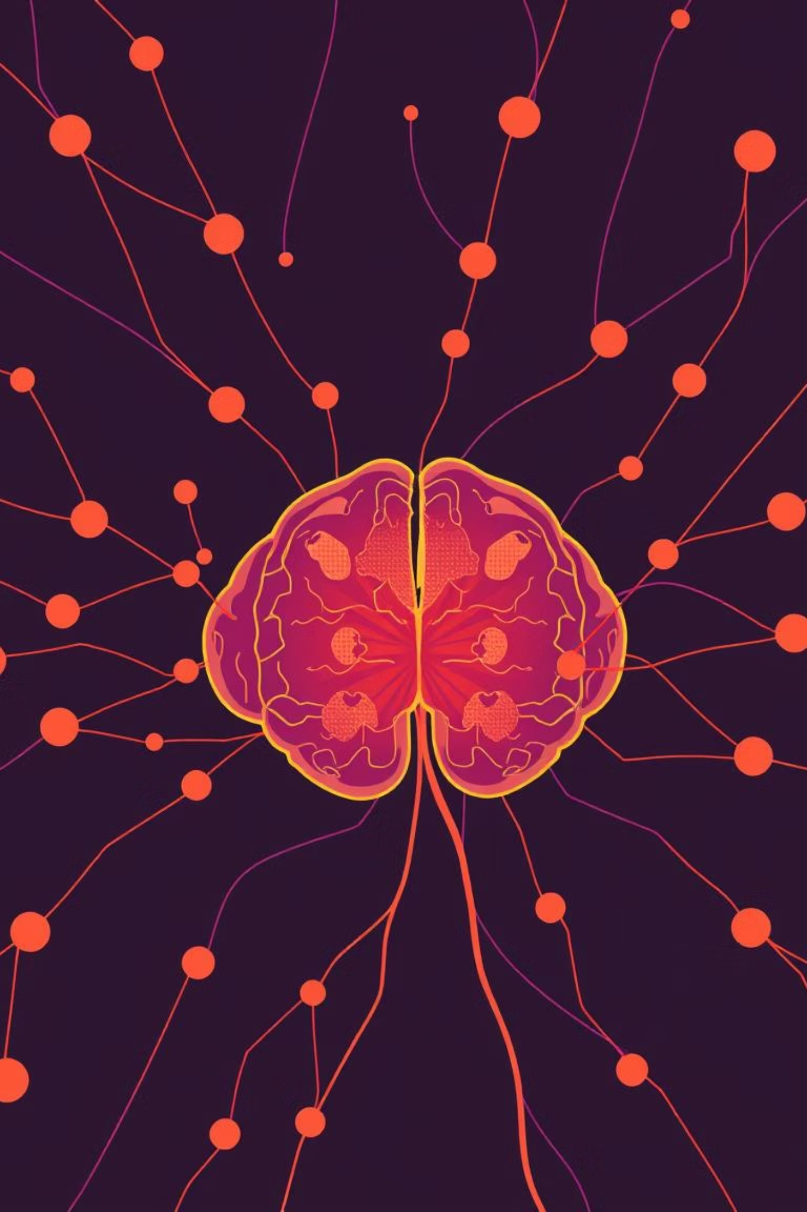
Grad-CAM: Unveiling AI Decisions
To provide transparency, we implemented Gradient-weighted Class Activation Mapping (Grad-CAM. This technique helps visualize the specific regions of an X-ray that influence the AI's diagnosis.
01
02
Technique: Grad-CAM
Logic: Gradient Tracking
Grad-CAM tracks gradients flowing into the final convolutional layer of our EfficientNetB0 model.
By analyzing these gradients, we identify which parts of the input image are most relevant to the AI's prediction.
03
Output: Heatmap Overlay
The result is a heatmap overlaid on the original X-ray, visually indicating the areas of interest for the AI.

Slide 44
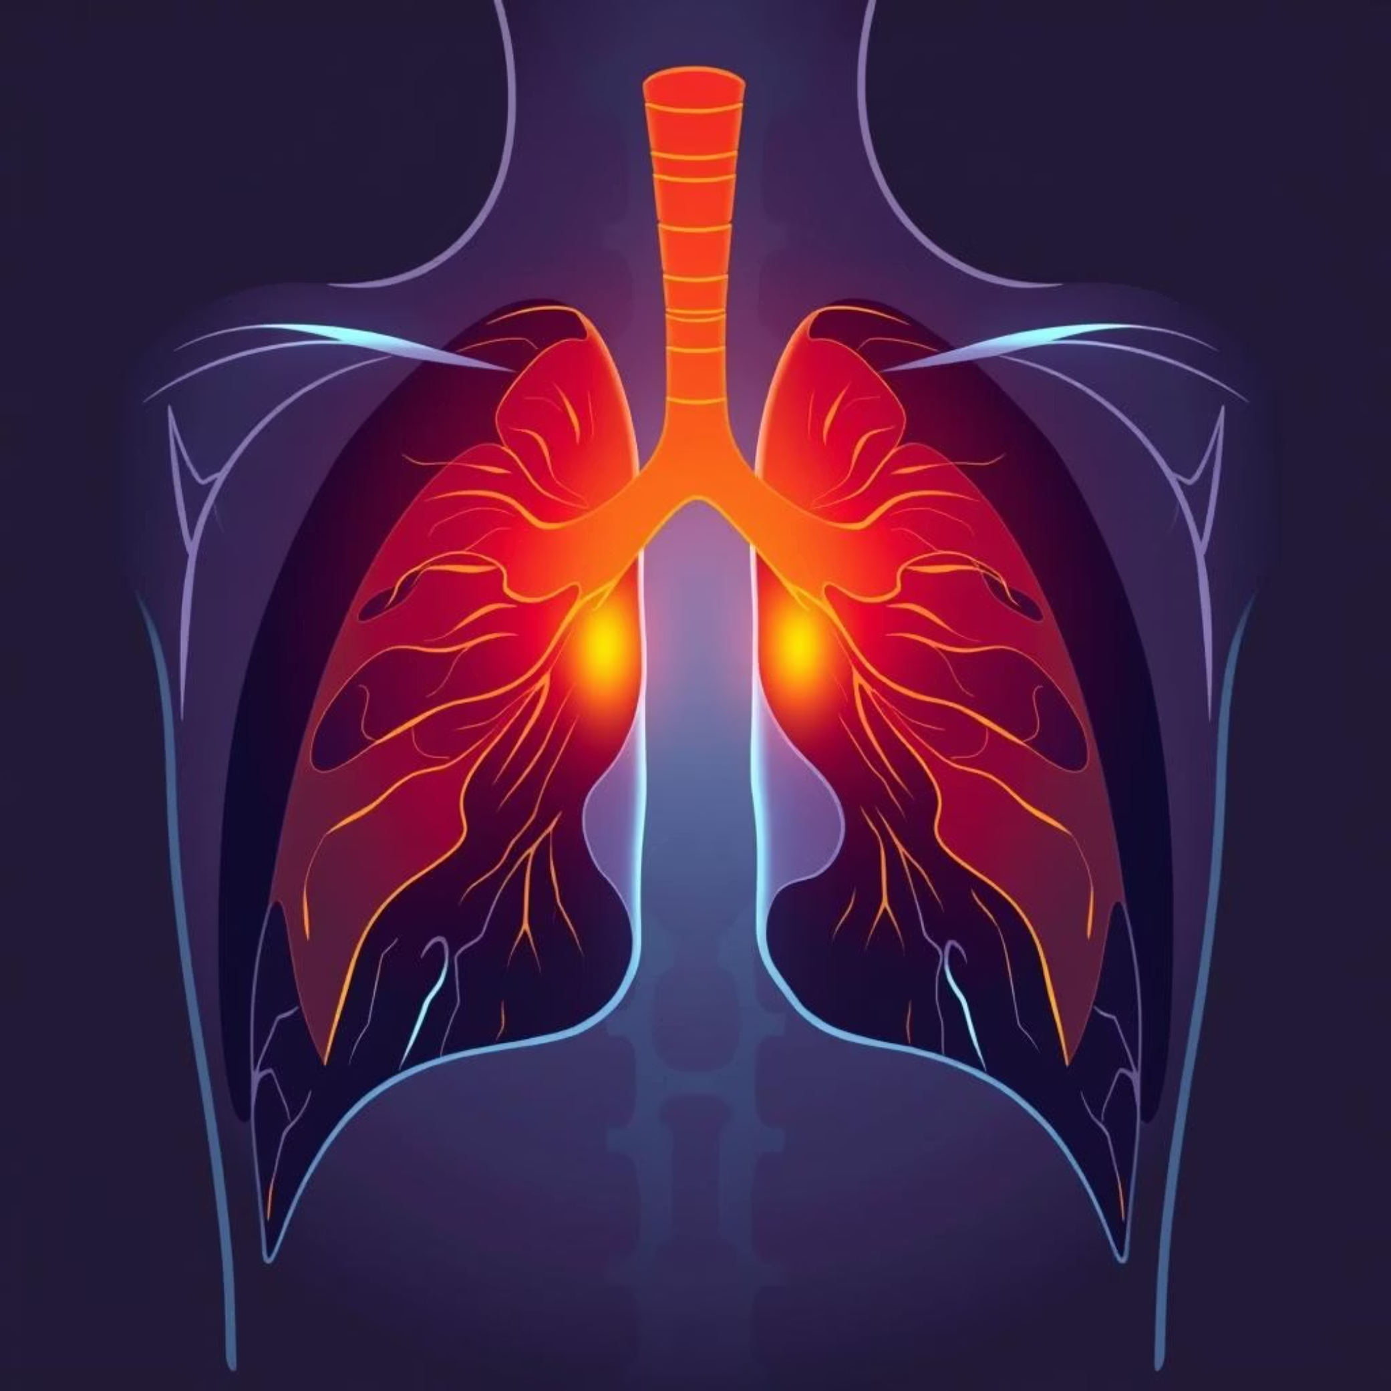
Visualizing Diagnostic Results
Success: Lung Lobe Highlight
A successful Grad-CAM heatmap highlights the lung lobes, precisely where pneumonia typically occurs, confirming the AI's focus on relevant anatomical regions.
Failure Check: Irrelevant Highlights
If the heatmap highlights areas like the shoulder or text on the X-ray, it indicates a model error, prompting further investigation into the AI's reasoning.

Slide 45







Deployment & Application: Our Tech Stack
Our solution is built on a robust and efficient tech stack, ensuring accurate model training, seamless backend operations, and a user-friendly frontend experience.
Model Training
Backend
TensorFlow/Keras on Google Colab Pro (GPU) for high-performance model development.
Python Flask provides a lightweight and powerful framework for our server-side logic and API.
Frontend
HTML5 + JavaScript (Async/Await) delivers a responsive and interactive web interface.

Slide 46


Intuitive Web Interface
We designed a simple, clean medical interface to facilitate easy interaction with the AI diagnostic tool.
Simple, Clean Design
A user-friendly interface optimized for medical professionals, ensuring clarity and ease of use.
Drag & Drop Upload
Effortless file uploading for X-ray images, streamlining the diagnostic process.
Instant Feedback
Immediate diagnostic results and visual heatmaps for quick analysis.

Slide 47

Backend Logic: app.py
The core of our application's intelligence resides in the backend logic, specifically within the /predict route, which orchestrates the diagnostic workflow.
Gatekeeper Check
MobileNetV2 first verifies if the uploaded image is indeed an X-ray, ensuring data integrity.
Preprocessing
Images are resized to 224x224 and normalized for optimal model input.
Inference
EfficientNetB0 then predicts the disease based on the preprocessed X-ray.
Grad-CAM Generation
A heatmap image is generated to explain the AI's diagnostic decision.
JSON Response
The system returns a JSON object containing the predicted class, confidence score, and the Base64-encoded heatmap image.

Slide 48
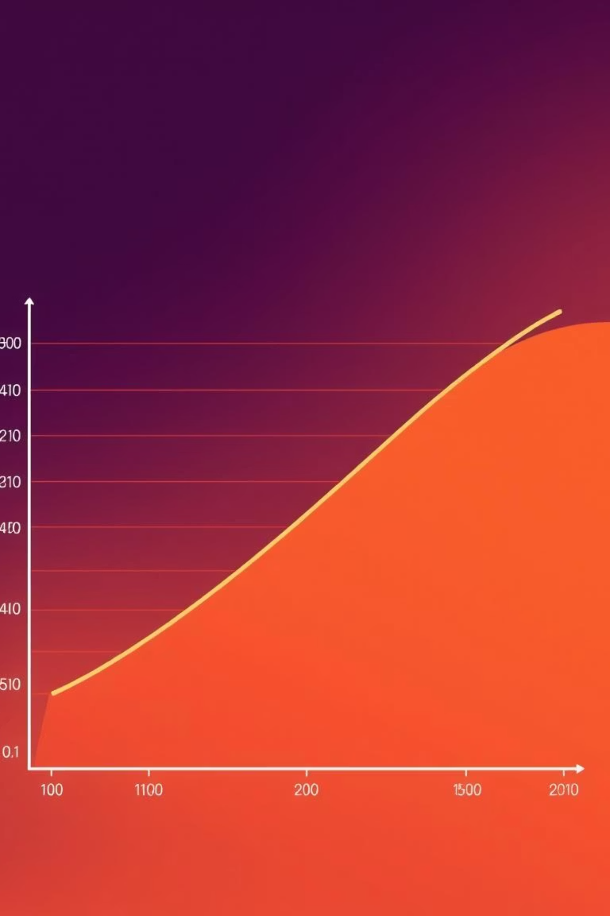
Performance Summary & EfficientNetB0 Advantages
Our AI model demonstrates strong performance across all stages, leveraging EfficientNetB0 for its superior speed, compact size, and comparable accuracy.
Performance Metrics
Why EfficientNetB0?
100%
Speed: 5x Faster
Significantly quicker inference than VGG16, enabling rapid diagnoses.
Gatekeeper Accuracy
Ensures only relevant X-ray images are processed.
Size: <20MB
93%
A compact model file, ideal for deployment in resource-constrained environments.
Binary Classifier Accuracy
High accuracy in distinguishing between general categories.
Accuracy: Comparable
Achieves accuracy on par with much larger models for this specific task.
85%
Multiclass Classifier Accuracy
Efficient and fast, providing reliable multiclass predictions.

Slide 49






Clinical Impact & Future Roadmap
Our AI solution offers significant clinical benefits and has a clear roadmap for future enhancements to further improve medical diagnostics.
Clinical Impact
Future Roadmap
Triage Prioritization
Segmentation
Helps prioritize urgent cases for radiologists, optimizing workflow.
Integrate U-Net for precise lung isolation before classification.
Enhanced Access
Federated Learning
Provides expert-level diagnosis to low-resource areas via web/mobile platforms.
Enable training on distributed hospital data while preserving patient privacy.
Medical Education
Mobile App
Heatmaps serve as valuable tools for training junior doctors.
Develop a TensorFlow Lite mobile app for offline Android/iOS use.

Slide 50

Data Sources & References
Our models were trained and validated using diverse datasets and informed by key literature in the field of deep learning.
Diagnostic Datasets
Key Literature
COVID-19 Radiography Database: For COVID-19, Viral Pneumonia, and Lung Opacity.
EfficientNet: Rethinking Model Scaling for CNNs (Tan & Le).
Tuberculosis (TB) Chest X-ray Database: Dedicated source for TB positive cases.
Grad-CAM: Visual Explanations from Deep Networks.
Chest X-Rays (Pneumonia): Distinguishes Bacterial, Viral Pneumonia, and Normal cases.
Gatekeeper Datasets
Purpose: Trained to distinguish "Chest X-Rays" from "Everything Else."
"Everything Else" Data: Curated subset of ~4,000 images from MedNIST, Bone Fracture X-rays, and Random Objects (cars, planes, people, animals, everyday items).
Questions & Discussion
We are now open for any questions you may have regarding our project.

